Slide 1
Git and GitHub: It’s not so bad!
Michael Phillips
Lab Meeting
January 25, 2019

Slide 2
Git is not GitHub
Git is a distributed version control system (VCS) for tracking source code. Its goals are: speed, data integrity, and support for distributed, non-linear usage.
GitHub is a web hosting service that uses git for version control. It offers all the features of git as well as adding new features.

Slide 3
Git is not GitHub
Git is a distributed version control system for tracking source code. Its goals are: speed, data integrity, and support for distributed, non-linear usage.
GitHub is a web hosting service that uses git for version control. It offers all the features of git as well as adding new features.

Slide 4
What is a Version Control System?
Software that records changes to a file over time and allows you to return to specific versions if necessary.
A version contains a state and a description.
Microsoft Word supports versioning.
Google docs has an even better version control.

Slide 5
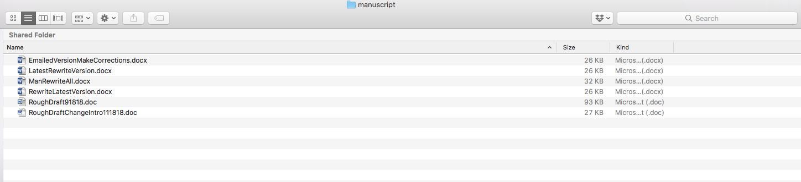
When people do not have adequate version controls they tend to improvise their own.

Slide 6
Importance for source code
Recover deletions and lost files
Allow multiple people to work on same file
Track who has made changes to the code
If something breaks, you can go back to prior versions.
More transparency as it allows outsiders to see what changes have been made over time to the code.
Notes:
Been around since the 80s.

Slide 7
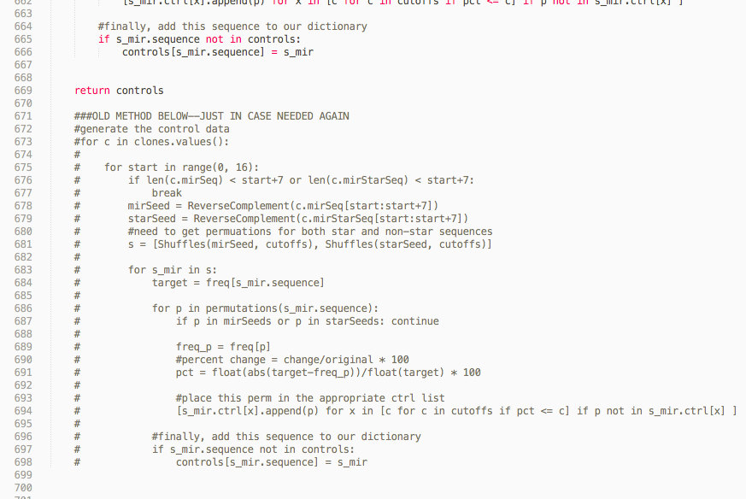
Programmers also improvise their own version control, primarily by overuse of block comments for code they no longer need but are afraid to delete.

Slide 8
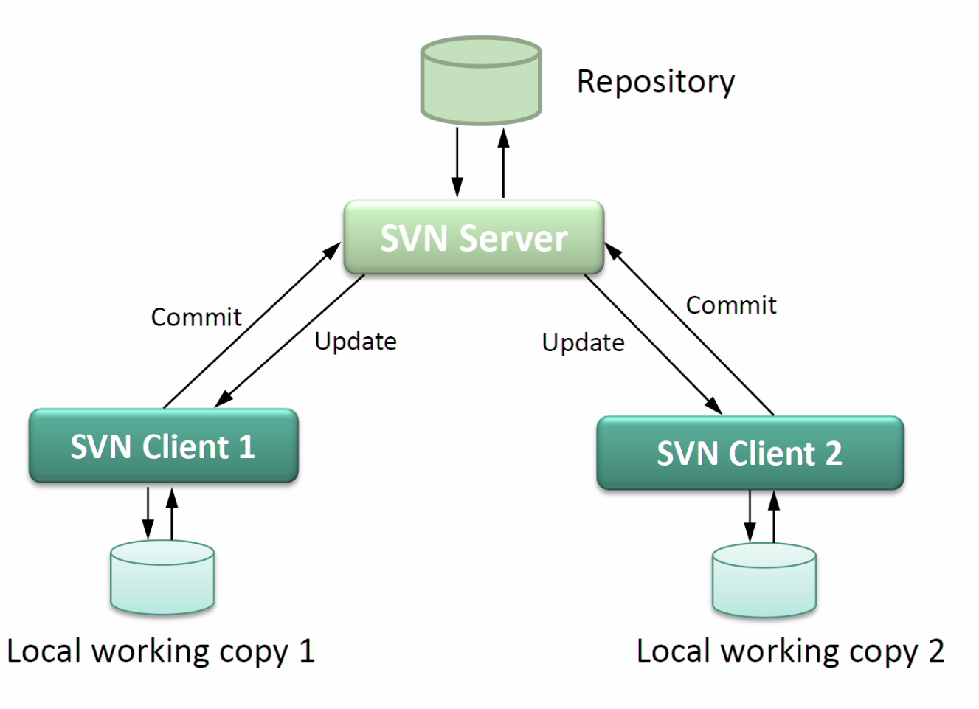
Client & Server Model
Prior to git, most VCS were based on a centralized model. Examples: Mercurial, Subversion.
Server holds entire code base. Developers check out the latest version of a file by copying to their computer.
Notes:
Prior to git most version control used a client server model rather than distributed. For example Subversion, Mercurial, CVS

Slide 9
Advantages and Disadvantages
Advantages:
Centralized behavior allows for more secure access controls to certain parts of code.
Works better with large binary files.
More mature system, better tools, particular GUIs.
Requires server to function at all.
Disadvantages:
Central point of failure can make it more vulnerable. Also more dependencies such as database storage.
Slower performance
Not available offline!
Notes:
Slower performance: All changes sent to server, more network traffic, slower performance. Must connect to server and download for almost all operations like diff and status.

Slide 10


Enter git
Created by Linus Torvalds in 2005 for development of the Linux kernel.
Replaces Server-Client model with a distributed system.
Designed for fast branching and merging operations.
Stronger safeguards against file tampering, accidental or malicious.
“I'm an egotistical bastard, and I name all my projects after myself. First 'Linux', now ‘git’.” —Linus Torvalds
Notes:
BItKeeper, was previously open source, copyright owner made it proprietary. Users revolt and both git and mercurial were created in response.

Slide 11
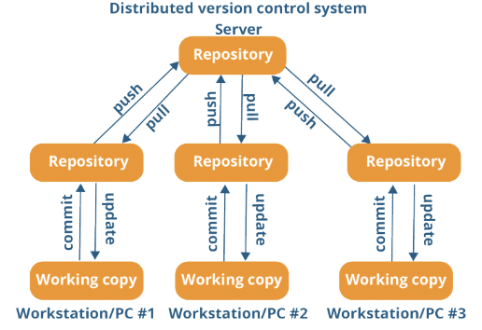
The distributed model
Each contributor has a local clone of the main repository.
Most operations are performed on local copy: very fast and does not require access to remote server.
Contributors can share locally between themselves.
No single point of failure. If server is lost, can be recreated from any user’s local copy.

Slide 12
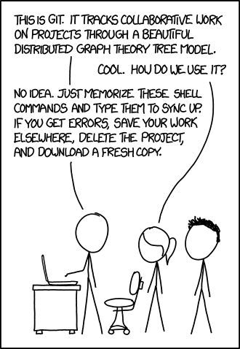
Problems
Complexity.
Vast number of commands, most of which you will not need to use.
Intimidating to new users. No reasonable GUI version, to properly use git, users must learn to use command line.
Originally created for linux programers. Even with increased popularity, little effort has gone into improving the beginner experience.
https://xkcd.com/1597/

Slide 13
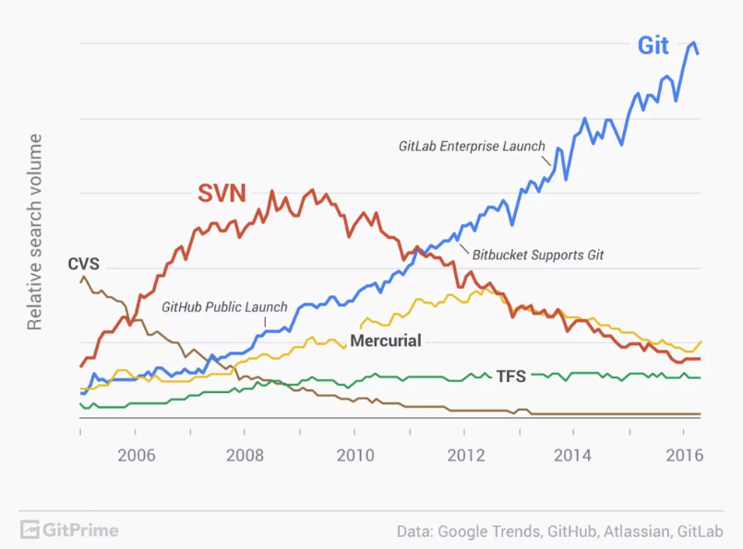
SVN has been losing market share to git for years now.
Still has many users particularly on larger projects.
SVN is the de facto standard in corporate and enterprise environments.

Slide 14
Why is git so popular?
Distributed model fits better with current tech environment.
Branching and merging is flawless and happens almost instantly.
Local staging area allows offline use.
Created by open source programming legend Linus Torvalds.
GitHub!!

Slide 15
GitHub is a free hosting service for remote git repositories, but adds many other features as well as a social networking component.
Huge in open source community, most open source projects are published on GitHub.
Most popular way to publicly publish your code.
Has over 31 million users with over 96 million repositories.
Purchased by Microsoft in 2018 for 7.5 billion dollars.

Slide 16
Why should you use GitHub?
Centralized storage and versioning. Your code is backed up and safe. Prior versions give you freedom to experiment and try new things in a safe environment.
Others having access to your code encourages better documentation and programming practices.
Many others can learn and use your hard work! Both inside and outside our lab.
Looks really good on your resume!

Slide 17
Advantages for science?
Research hosted on GitHub is reproducible and fully transparent.
A lab notebook for programmers.
Other researches can use your work to explore new areas rather than recreating it from nothing.
Can share datasets in addition to code.
Greatly reduces the chances of accidental oversights, e.g. forgetting a crucial part of code added late is not described in your manuscript.
Increased sharing of code and data is associated with higher citations.
More info: https://github.com/karthik/smb_git

Slide 18
How to use git and GitHub

Slide 19
Learning the command line
Though intimidating, the command line interface (CLI) is the best way to learn to use git.
It is the standard language of git. If you learn these commands you will be able to use git on any system.
You will always be able to search for command line help online.
Most options are not available without using the CLI.
Bonus: Learning CLI is important background for future computational work!

Slide 20
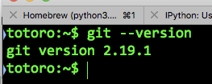
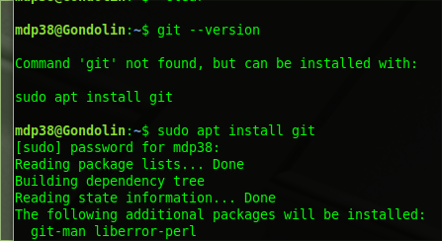
Installation
Mac OS X
Open terminal
git —version
If it shows a version it is installed. If not a window will pop-up offering to install x-code. Accept the offer and git will now be installed.
Ubuntu Linux
sudo apt-get install git
Microsoft Windows
https://gitforwindows.org/
Installs a CLI and GUI

Slide 21
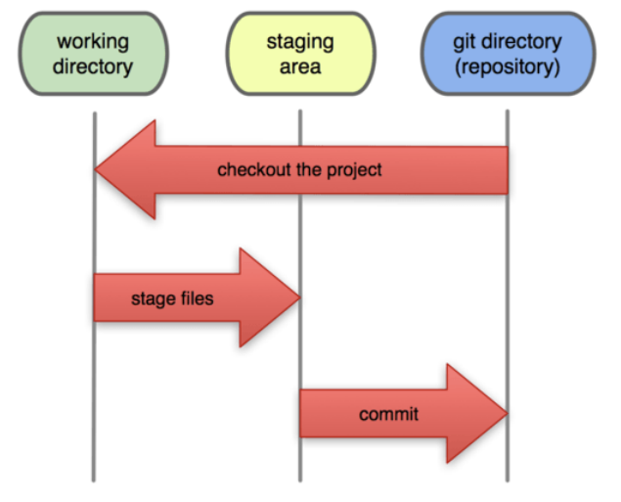
Basics
3 areas: working directory, staging area, and the repository.
Remote repository is a clone of your local git repo. Update it when you want to save your changes to the cloud.
Working directory is just your local computer folder.

Slide 22
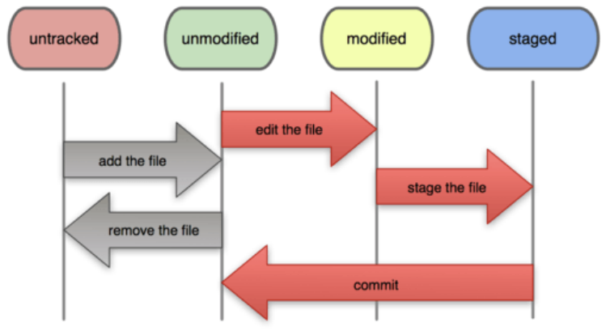
Staging Area Operations
Files tracked by git but not yet saved to local repo.
With commit, everything in staging area gets saved to the local git repo.
git add <file> = adds <file> to the staging area, ready to commit.
git status = shows all files being tracked and in staging area. Gives commands to remove from staging area.

Slide 23
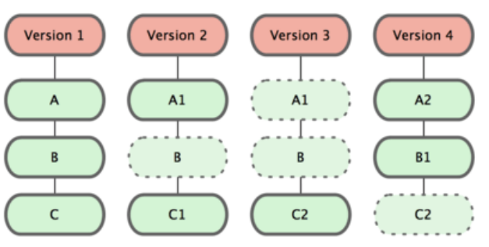
What is a repository?
A complete snapshot of the entire file system of your project over time. Does not track just individual files.
Can track or return to any commit in the entire history of the repository.

Slide 24
Local Repo Operations
git commit -m <message> Commit all files to the local repo.
Writing a good commit message is very important.
git log lists all commits in chronological order.
git reset —hard <commit-id> reverts back to given commit.
git reset —hard HEAD~n reverts back n commits.

Slide 25
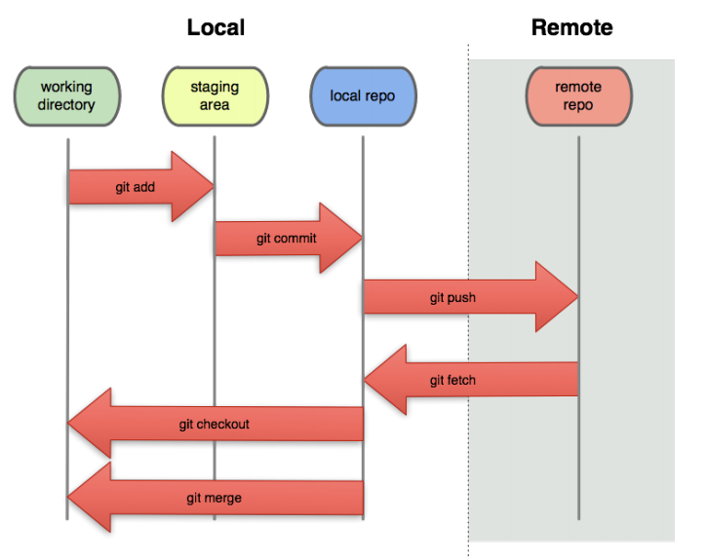
Remote Repository
Repositories hosted on a service like GitHub.
Allows code to be shared among all developers and eventually published to the community at large.
git remote add <name> <url> Inform git of GitHub remote at url.
git push <remote> <branch> Push local repo to GitHub
Example: git push origin master
git pull <remote> <branch> fetch and merge changes from GitHub to your local repo.
git clone <git-url> Create local repo identical to given GitHub repo.

Slide 26
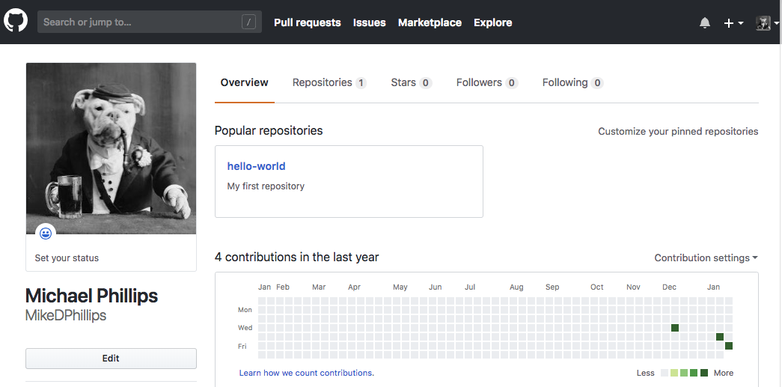
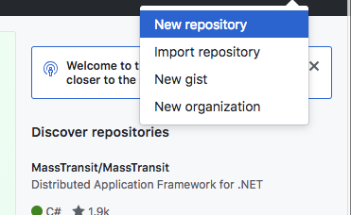
Getting Started with GitHub
Create an account at GitHub.
https://github.coecis.cornell.edu/
Tempting to use your Cornell NetID, but consider using something that identifies you better and is not tied to any one school or employer.
Time to create your first GitHub repository.

Slide 27
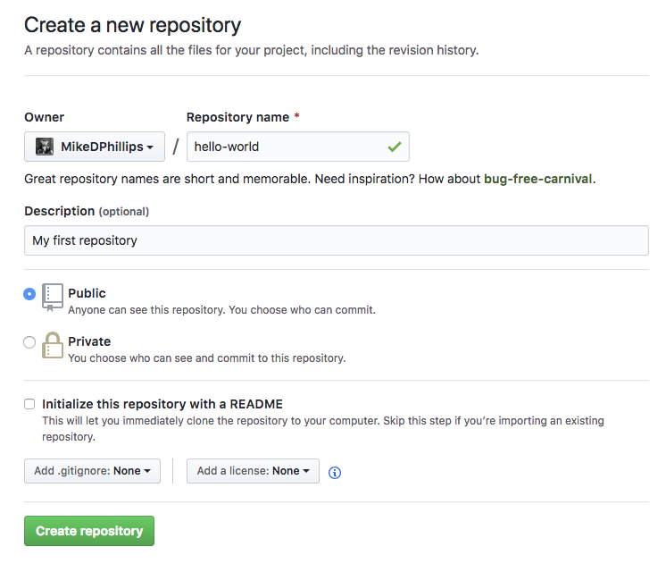
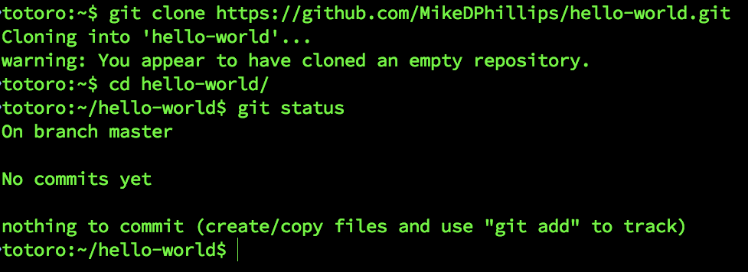
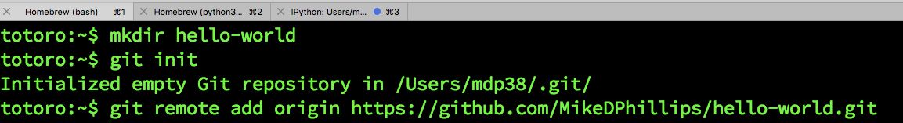
Clone remote repo:
Create on command line:

Slide 28
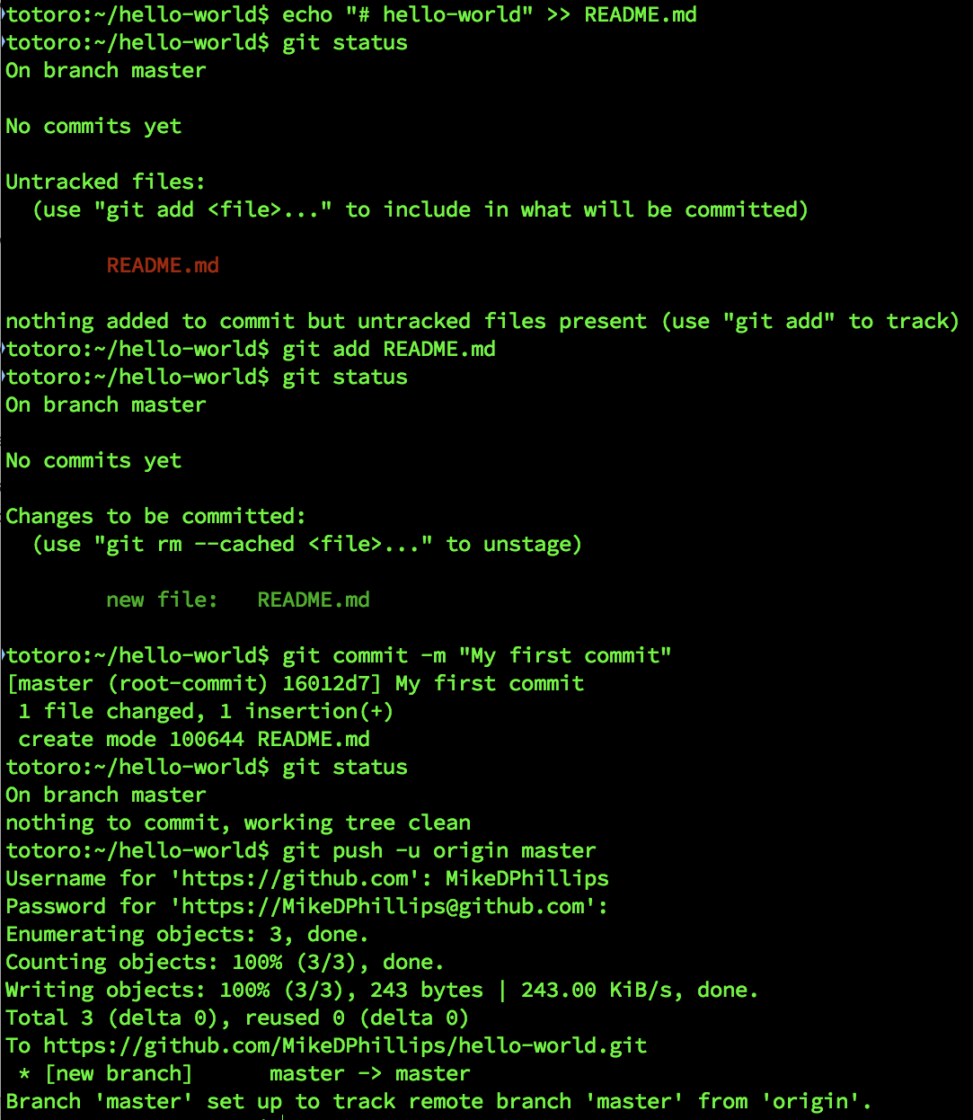
Upload your first file to GitHub
Create a file in your working directory
Add the file to the staging area
Commit the file to the local repository
Push the local repo to GitHub
Now try it with images and other files.

Slide 29
Avoiding Problems
Never make a git repository inside another git repository
Never edit files directly on GitHub.
Commit often, but don’t go crazy. Too many commits make reversion more difficult.
If you mess up too bad you can always delete the local folder and clone the remote repo to start over.
Always write sensible commit messages.

Slide 30
Why commit messages?
So others can make sense of what changes you’ve made—including future developers working on your code or trying to learn it. Or so that you remember months later.
If you find a serious bug was introduced in a given revision, it is very useful to know exactly what was changed in that revision without having to trudge through the code.
Short, honest messages are helpful as well if no long explanation is needed.
“Cleaned up data and removed unnecessary columns”
“I broke the last build. Here are the files I forgot to add”

Slide 31
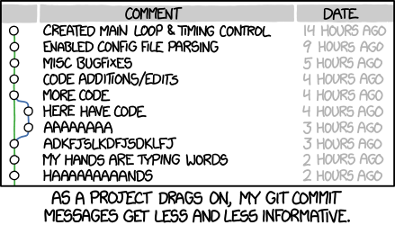
Good & Bad Messages
Short (50 chars or less) summary of changes
More detailed explanatory text, if necessary. Wrap it to
about 72 characters or so. In some contexts, the first
line is treated as the subject of an email and the rest of
the text as the body. The blank line separating the
summary from the body is critical (unless you omit the body
entirely); tools like rebase can get confused if you run
the two together.
Further paragraphs come after blank lines.
- Bullet points are okay, too
- Typically a hyphen or asterisk is used for the bullet,
preceded by a single space, with blank lines in
between, but conventions vary here

Slide 32
Further GitHub Topics

Slide 33
Branching and Merging
Branching creates a separate area to work outside the master branch.
A change made in one branch does not show up on other branches unless they are merged.
A common pattern is to always keep the master branch tested and working. New features or bug fixes can be worked on in branches. When those are fully working they can be merged back into master.
Always delete branches when they are merged and no longer needed.

Slide 34
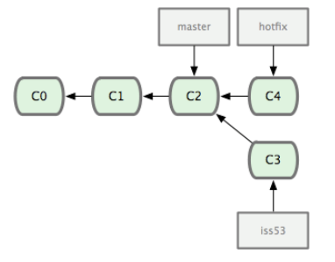
Merging Example
Two branches: hot fix and iss53
Both diverge from master at c2
hotfix is an import bug fix and iss53 implements and improved regression model.

Slide 35
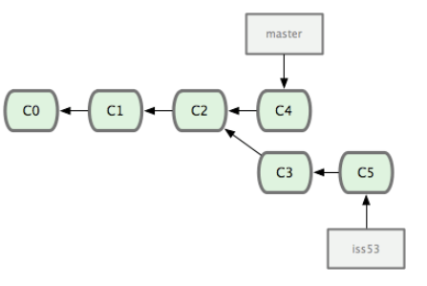
Merging Example
Merging hotfix is simple
git checkout master
git merge hotfix
git branch -d hotfix
Notes:
checkout master says you want to work on that branch
merge says to merge in hotfix
can delete branch after successful merge IMPORTANT

Slide 36
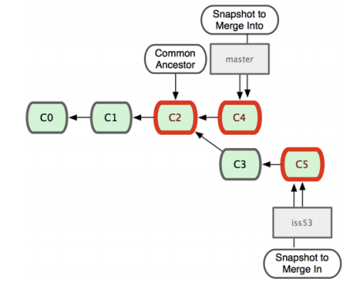
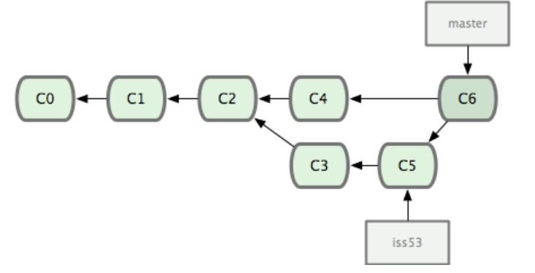
Merging Example
More difficult as there are multiple versions of files that must be merged.
Git does this automatically for you! But if there are conflicts it will stop and make you manually decide which version to use.

Slide 37
Project Pages
GitHub now offers the ability to host a website directly from your repo. http://<username>.github.io
Can be used for anything:
A blog
A portfolio of your projects, research, and CV
A walkthrough of any projects you think need further explaining or information.
Teaching or class pages.

Slide 38
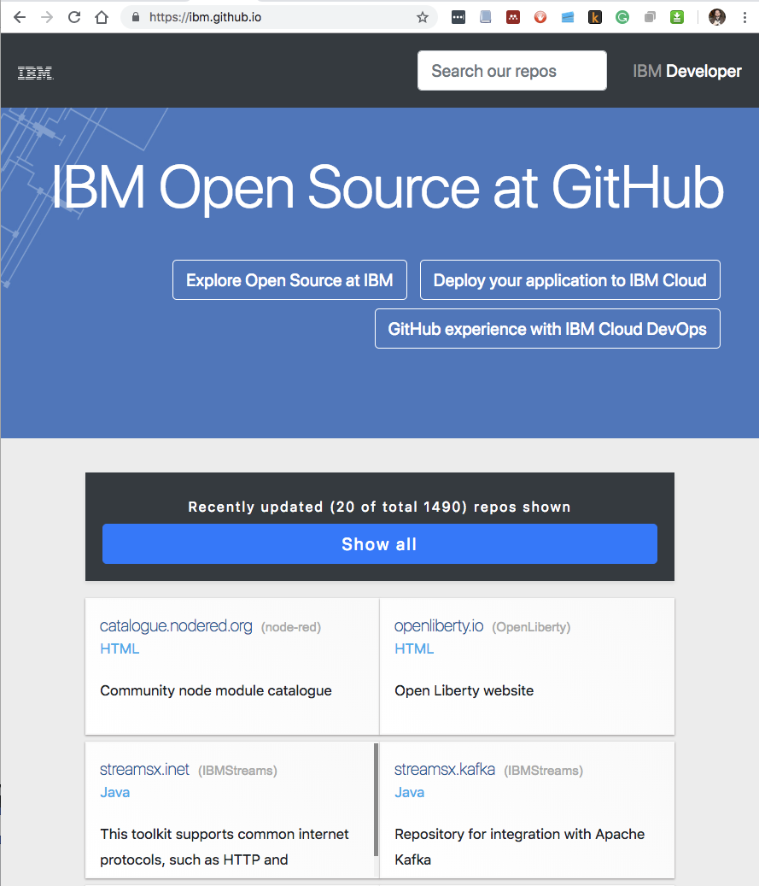
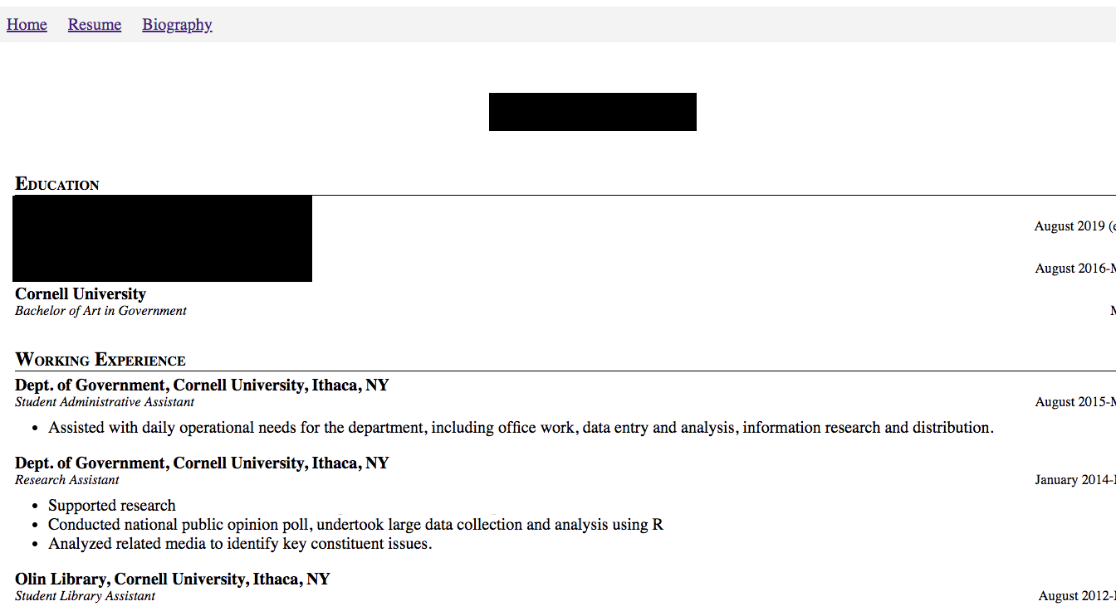
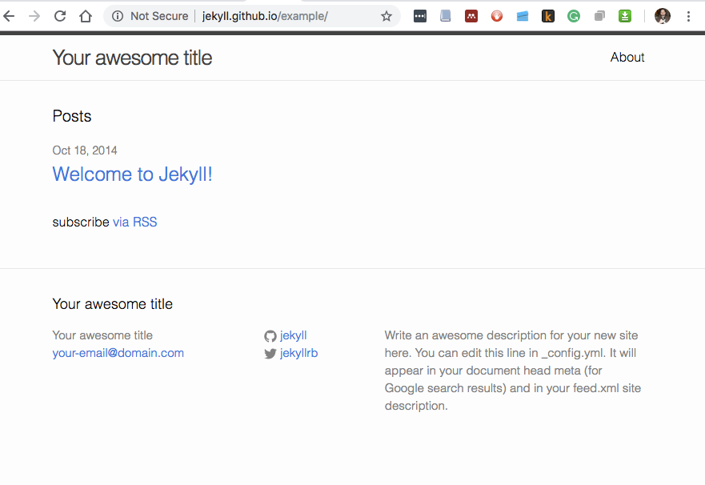

Slide 39
Creating your GitHub page
Create the repo YOUR_GITHUB_USERNAME.github.io
Your site must exist on the master branch. Push your web files to this branch and then you can view at
http://<username>.github.io
More info: https://help.github.com/articles/what-is-github-pages/

Slide 40
Further reading
Github Transparency in Research
http://zmjones.com/git/
Sharing Data Increases Citations
https://www.liberquarterly.eu/articles/10.18352/lq.10149/
10 Rules for Taking Advantage of GitHub
https://www.ncbi.nlm.nih.gov/pmc/articles/PMC4945047/
Easy fixes for common git problems
http://ohshitgit.com/
Git cheat sheet
https://education.github.com/git-cheat-sheet-education.pdf
Using Git with R
https://happygitwithr.com/index.html
Using git with R Studio (make sure you understand CLI first!)
http://r-pkgs.had.co.nz/git.html#git-rstudio
Advanced information on git object storage and graph theory
http://eagain.net/articles/git-for-computer-scientists/

Slide 41
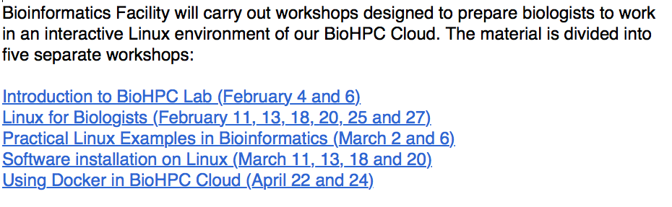
BioHPC Workshops

Slide 42
Acknowledgements
Martin, Nicole, and Renata
All MQIP/FSL Lab Members
Everyone
Thank you!

